Slide 1
DATA ANALYSE - UK GENERATION PROJECTS
APPLYING OUR LEARNING - ANALYSING DATA
da-lon2 - Abdul, Alan, Alisha, Jenny and Shayanny

Slide 2
PRESENT THE DATA
In this Interim Project, we work on AdventureWorks - Microsoft SQL Server sample database
The AdventureWorks database supports standard online transaction processing scenarios for a fictitious bicycle manufacturer (Adventure Works Cycles). Scenarios include Manufacturing, Sales, Purchasing, Product Management, Contact Management, and Human Resources.
We also have used the AdventureWorks Data Dictionary to check and guide us on database observation.

Slide 3
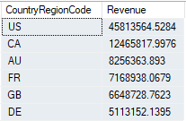
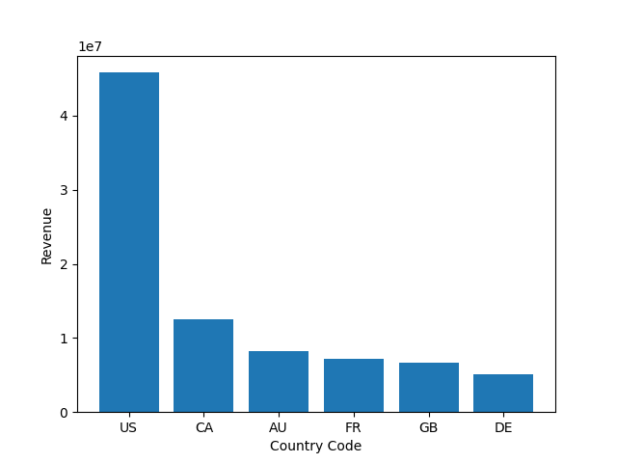
1.What are the regional sales in the best performing country?
Revenue by Country aggregated by Sales.SalesTerritory
The best performing country is US

Slide 4
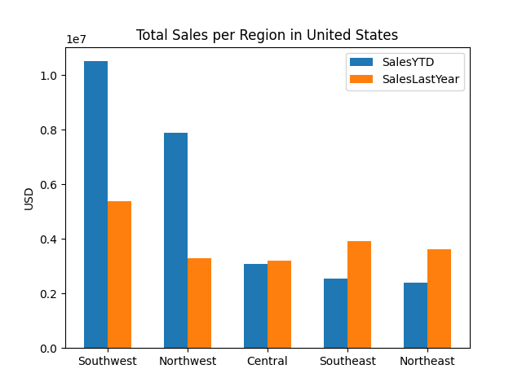
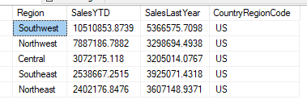
Regional Sales in US
Southwest has the highest sales in US

Slide 5
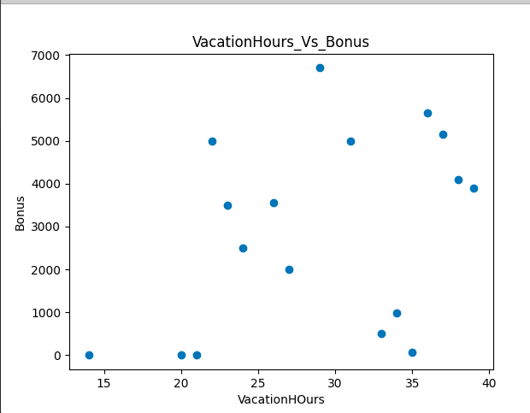
2.What is the relationship between Annual leave taken and Bonus
There is a positive relation between Annual Leave Taken and Bonus, But it is not a strength correlation. The greater the number of hours taken on vacation, the greater the amount earned in bonuses.

Slide 6
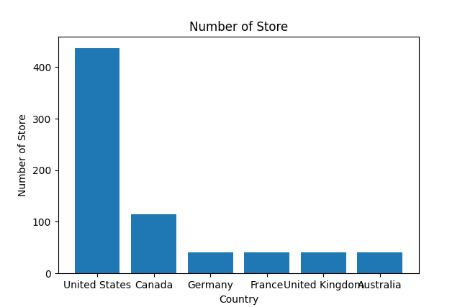
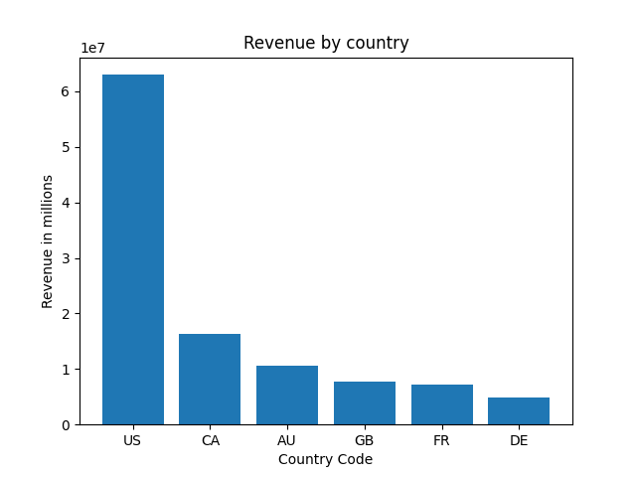
3.What is the relationship between Country and Revenue?
The revenue is correlated with the number of stores in each country.

Slide 7
3.What is the relationship between Country and Revenue?
The revenue is correlated with the number of stores in each country.

Slide 8
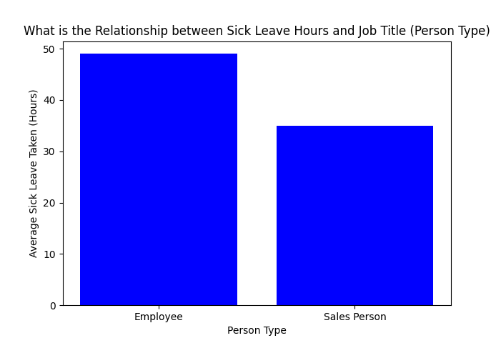
4. What is the relationship between sick leave and Job Title ?
Employees are more likely to take sick leave compared to Sales People.
More employees in the organization than sales people.

Slide 9
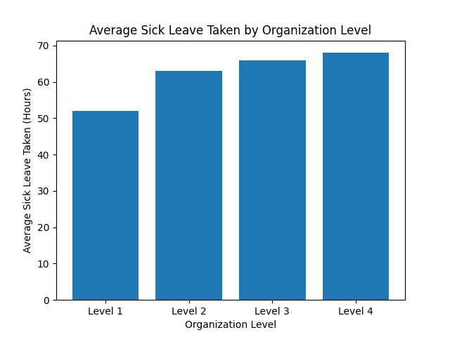
Sick Leave by Organization Level
The higher up the organization you go, the less sick leave is taken.
Job Titles
Level 1: Chief Financial Officer, Vice President roles,
Level 2: Managerial roles
Level 3: Supervisor roles
Level 4: Assistants, Clerks, Stockers
Lower the level = More senior role

Slide 10
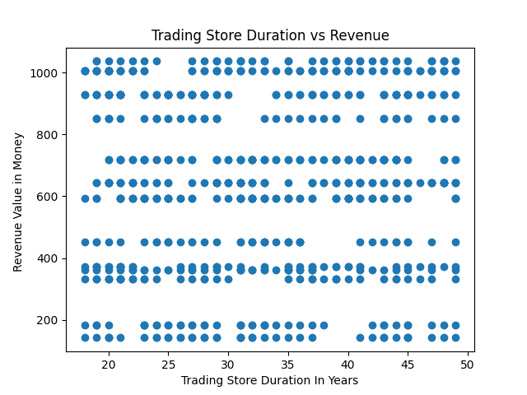
5. What is the relationship between store trading duration and revenue?
There's none Relation between Store Trading Duration (in Years) and Revenue. The Revenue from each store name are not relation with your duration time.

Slide 11
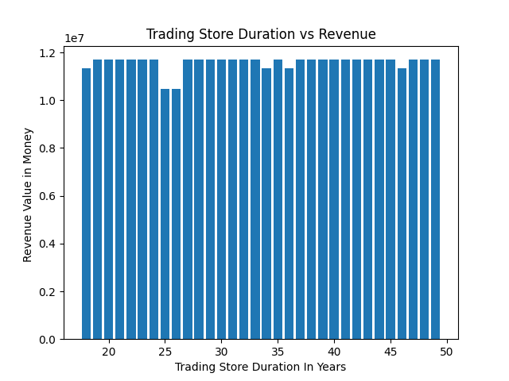
Revenue in Billions vs Store Duration in Year
We can see the revenue decreased in specific duration stores, but we can not consider it as relevant). There's none variation.

Slide 12
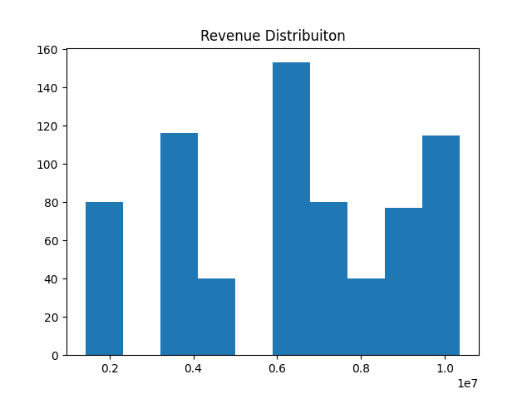
Also, the Revenue value there's none normalized distribution. Which doesn't mean much, but assumes he doesn't follow a standard behavior

Slide 13
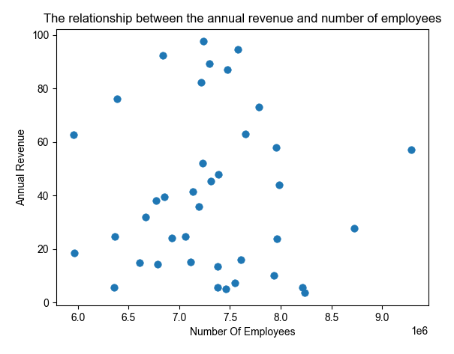
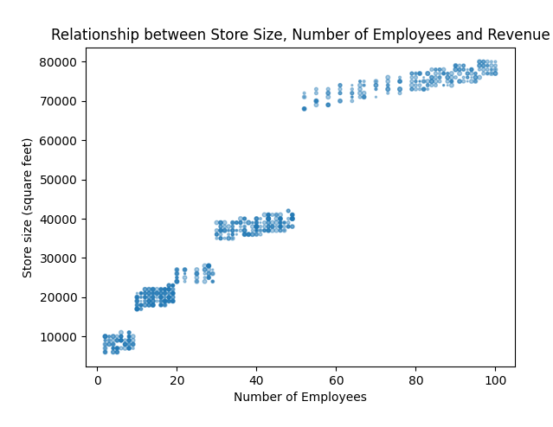
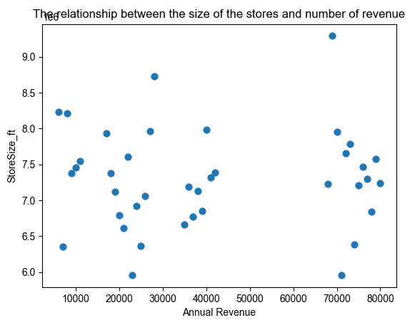
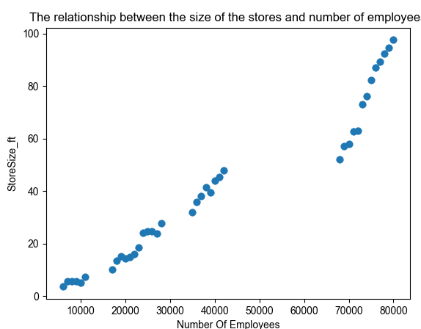
6. What is the relationship between the size of the stores, number of employees and revenue?
There was no correlation between the annual revenue or the number of employees or the size of the stores and the number of revenue.
However there was a relation between the size of the stores and number of employees. Both factors had a strong positive correlation. So I was able to infer that the larger a store is, the number of employees increases.

Slide 14
Conclusion - What we have learned?
Explore the dataset using SQL Server
Use SQL query to extract needed data from the dataset, then export as a csv file
Use pandas and matplotlib in python to visualize the data, answer the question
Use GitHub to collaborate in the project as a Team
TEAMWORK

Slide 15
THANK YOU !
da-lon2 - Abdul, Alan, Alisha, Jenny and Shayanny

